Slide 1




Troop 109 Leadership Training
 | www.mptroop109.com …celebrating its 70th year…

Slide 2
Why Are You a Leader?
Why Are You a Leader?
(Why Are You Here?)
I want to accomplish something and be effective in my role
Learning to be an effective leader will help me later in life
Required for rank advancenent on my way to Eagle Scout
I was elected by my peers
I had no homework and nothing better to do on a school night…
My father told me to do it!

Slide 3
What Does It Mean to Be an Eagle Scout?
Merit Badges (but not only that)
Rank Advancement (but not just that)
Eagle Service Project (but not just that)
Outdoor Skills (but not just that)
Leadership and Life Skills (it’s all of that)

Slide 4
Troop 109
Leadership Training
Introduction to Leadership
What a leader must KNOW
How to Fulfill Your Role
Responsibilities and what a leader must BE
What Is Expected of Me
What a leader must DO

Slide 5
ALL SCOUTS LEADERS
These responsibilities pertain to ALL Scout Leaders, including youth and adult leaders
Act as good role models; set good examples
Show respect to other Scouts, leaders, and adults
Aware of Troop handbook and rules; follow them
Enthusiastically wear the Scout uniform properly
Live by the Scout Oath and Scout Law
Show Scout Spirit
Good attendance at Troop Meetings and activities
Devote time necessary to be effective leaders

Slide 6

Troop 109 Handbook

Slide 7
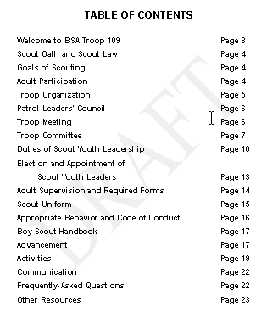
Troop 109 Handbook

Slide 8
Words to live by…
Scout Oath
On my honor, I will do my best
To do my duty to God and my country
and to obey the Scout Law;
To help other people at all times;
To keep myself physically strong,
mentally awake, and morally straight.

Slide 9
Words to live by…
Scout Law
A Scout is:
Trustworthy Obedient
Loyal Cheerful
Helpful Thrifty
Friendly Brave
Courteous Clean
Kind Reverent
Scout Motto
Be Prepared
Scout Slogan
Do a Good Turn Daily

Slide 10
What Else Do I Have to Do
As a Leader?
Know the responsibilities of your role
Lead by example (respect is earned!)
Motivate (why they want to do it)
Get to know other Scouts
Define “success” in your position
Learn from EACH leadership opportunity
Leadership is NOT easy…but it’s worth it
Ask for help when you need it

Slide 11
Doing it Better!
It is good for a leader to assess (and reassess) how he is doing as a leader.
Ask yourself…
Start—What should I start doing that I’m not doing now?
Stop—What should I stop doing that is not working?
Continue—What should I continue doing that is working well and helps us to succeed?

Slide 12
The EDGE™ in Teaching
EDGE™ is the teaching method used by BSA. The key to making EDGE work is to use it for all teaching. Make it a habit!
Explain—The trainer explains how it is done.
Demonstrate—The trainer demonstrates while explaining again.
Guide—The learner tries the skill while the trainer guides him through it.
Enable—The learner works on his own under the watchful eye of the trainer. The trainer’s role in this step is to remove any obstacles to success, which enables the learner to succeed.

Slide 13
Troop 109 is…
Scout-Led
Scout Leaders
  Calendar
  Activities
    Outdoors
    Community Service
  Meetings
  Patrol Leaders’ Council (PLC)
Adult Leaders
  Ensure Safety
  Logistics
  Financial Support
  Transportation
  Troop Committee

Slide 14
Troop 109 depends on…
Patrols!
Patrols are essential building blocks
Working together as a team
Elected leaders (show them respect)
Scouts can accomplish more as a patrol, than as individuals
Patrols can enjoy achievements of the patrol and of its members
Elections held every 6 months

Slide 15
TROOP 109
ORGANIZATION CHART
Scoutmaster
(Scherm)
Assistant Scoutmaster
(Adams)
Assistant Scoutmaster
(Kopisch)
Assistant Scoutmaster (Lee)
Junior
Assistant Scoutmaster
Senior Patrol
Leader
(P. Kopisch)
Asst Senior Patrol Leader
(S. Shimbo)
Troop Scribe
(J. Adams)
Bear
Patrol Leader
(C. Scherm)
Panther
Patrol Leader
(T. Tam)
Patrol Leaders' Council
Bear Assistant Patrol Leader
(T. Liggett)
Panther Assistant Patrol Leader
(J. Adams)
Quartermaster
(T. Liggett)
Troop Guide
(D. Kopisch)
Merit Badge Coordinator
(J. Lai)
Service Coordinator
(J. Chow)
Bugler
(J. Adams)
Webmaster
(K. Lee)
Den Chief

Slide 16
SENIOR PATROL LEADER
Senior Patrol Leader (SPL) elected by Scouts as the top youth leader in the troop
Reports to: The Scoutmaster
Must be at least Star Scout rank to be eligible for position
Presides at all troop meetings, events, and activities
Sets agenda for and chairs PLC meetings
Assigns duties/responsibilities to other youth leaders
Ultimate responsibility for ALL Scouts in troop at all activities (even those he is unable to attend)
Interacts with adult leadership
Trains and supervises Troop Scribe in taking PLC minutes
Attends at least ¾ of PLC meetings during service period
Good attendance at Troop Meetings and activities

Slide 17
ASST SENIOR PATROL LEADER
Asst. Senior Patrol Leader (ASPL) elected by Scouts as 2nd highest youth leader in the troop
Reports to: The Senior Patrol Leader
Must be at least First Class to be eligible for position
Helps SPL with troop duties, meetings, and activities
Performs SPL’s duties in his absence
Helps train and supervise the Troop Guide, Troop Quartermaster, Service Coordinator, Merit Badge Coordinator, Webmaster, Den Chief, Troop Historian, and Troop Bugler
Attends at least ¾ of PLC meetings during service period
Good attendance at Troop Meetings and activities

Slide 18
PATROL LEADER
Patrol Leader elected by Scouts of his patrol
Reports to: The Senior Patrol Leader
Responsible for organizing, motivating (sharing and instilling Scout Spirit), and managing his patrol
Represents interests of his patrol members at PLC
Relays information to his patrol as needed
Prepares patrol for all troop activities, by leading or delegating responsibilities (including duty rosters if needed)
Has responsibility for all Scouts in patrol and for all patrol activities (even those he is unable to attend)
Knows what each patrol member can do
Attends at least ¾ of PLC meetings during service period
Good attendance at Troop Meetings and activities

Slide 19
ASSISTANT PATROL LEADER
Assistant Patrol Leader elected by Scouts of his patrol
Reports to: The Patrol Leader
Helps SPL with patrol duties
Performs Patrol Leader’s duties in his absence
Helps keep patrol members informed
Attends at least ¾ of PLC meetings during service period
Good attendance at Troop Meetings and activities

Slide 20
TROOP SCRIBE
Reports to: The Senior Patrol Leader
Must be at least First Class rank to be eligible for position
Keeps minutes of PLC meetings and submits them to the Scoutmaster and Troop Committee for approval, and at following PLC for approval
Ensures that minutes are taken at PLC meetings during his absence
Attends at least ¾ of PLC meetings during service period
Good attendance at Troop Meetings and activities

Slide 21
TROOP QUARTERMASTER
Reports to: The Assistant Senior Patrol Leader
Must be at least Second Class rank to be eligible for position
Keeps inventory of patrol and troop equipment (including literature, like Merit Badge books)
Keeps equipment in good working order
Issues equipment and literature, and sees that items are returned in good order and in timely manner (makes sure all equipment and supplies are in proper shape when returned and performs annual check of equipment not used within that year)
Suggests new or replaced items needed to PLC and Troop Committee
Works closely with adult Equipment Coordinator
Good attendance at PLC, Troop Meetings and activities

Slide 22
TROOP GUIDE
Reports to: The Assistant Senior Patrol Leader
Must be at least First Class rank to be eligible for position
Works with new Scouts on advancement to First Class rank
Teaches basic Scouting skills
May assist Patrol Leader in establishing a new patrol
Helps training of new Scouts by older Scouts
Good attendance at PLC, Troop Meetings and activities

Slide 23
MERIT BADGE COORDINATOR
Reports to: The Assistant Senior Patrol Leader
Must be at least First Class rank to be eligible for the position
Works with Scouts on completion of Merit Badges (especially toward Eagle Scout rank)
Identifies which Merit Badges are desired by Scouts and coordinates activities to accomplish them
Identifies, communicates, and coordinates Merit Badge Midway activities with Scouts
Maintains list of active Merit Badge counselors (whom Scouts can partner with on Merit Badge activities)
Good attendance at PLC, Troop Meetings and activities

Slide 24
SERVICE COORDINATOR
Reports to: The Assistant Senior Patrol Leader
Must be at least Second Class rank to be eligible for the position
Identifies community service activities of interest to the troop
Schedules and coordinates planning of community service activities (at least two per year)
Good attendance at PLC, Troop Meetings and activities

Slide 25
TROOP WEBMASTER
Reports to: The Assistant Senior Patrol Leader
Must be an active member of the troop with computer skills
Sets up and maintains Troop website (primary focus is on recruitment, secondary goal is usefulness for the troop)
Posts appropriate information, photos, files, and links to Troop website (for external and internal audiences)
Answers email inquiries to Troop website in timely manner
Ensures that all private information is secured and not accessible by external audiences
Works with Troop Treasurer to renew web hosting service contract on regular basis
Good attendance at PLC, Troop Meetings and activities

Slide 26
DEN CHIEF
Reports to: The Assistant Senior Patrol Leader and Den Leader of the Cub Scout Pack
Must be at least Second Class rank to be eligible for position
Works with a Cub Scout den as a guide
Serves as activities assistant at den meetings
Meets regularly with Den Leader to review den plans
Helps prepare Webelos scouts for Boy Scouting
Encourages Cub Scouts to join Boy Scout troop upon graduation
Attends at least 2/3 of den meetings during his service period
Projects a positive image of Boy Scouting and sets a good example
Good attendance at PLC, Troop Meetings and activities

Slide 27
Troop Committee
Makes safety high priority
Reviews Troop’s yearly plan
Supports the Scoutmaster in:
  Program planning
  Advancement
  Outdoor program
  Administration

Slide 28
Troop Committee
Chairperson
Scoutmaster
Asst Scoutmasters
Treasurer
Outdoor/Activities Coordinator(s)
Advancement Coordinator
Equipment Coordinator
Membership/Training Coordinators
Other Members
P. Lee
C. Scherm
F. Adams/M. Kopisch
P. Chau
F. Adams/K. Tam
D. Shimbo
D. Liggett
J. Farned/D. Rader
K. Kim/C. Pinto

Slide 29
Other Requirements
Annual Dues
Annual Health and Medical Form
Annual Permission Form
Appropriate Behavior and Conduct
Appropriate Attire

Slide 30
Advancement
Service Tracking Form
Leadership Form
Scoutmaster Conference
Board of Review
  Minimum of 3 members of Troop Committee

Slide 31
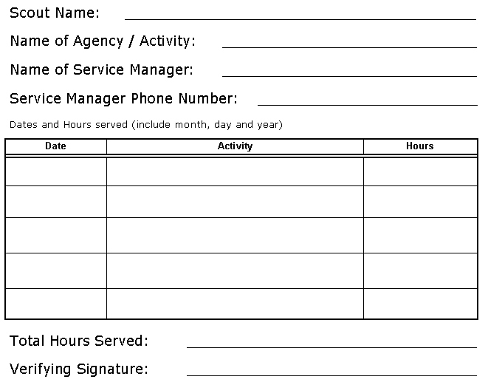
Service Tracking Form

Slide 32
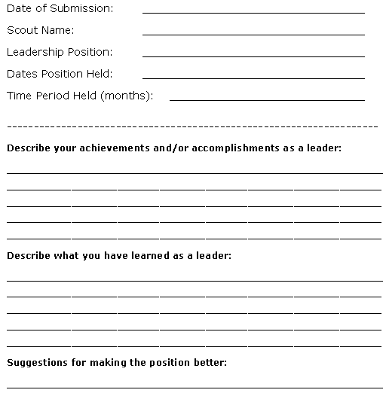
Leadership Form

Slide 33
Patrol Leaders’ Council
Attended by youth Scout leaders
Plans and organizes activities for troop and patrols
  Each patrol must have Patrol Leader, Asst Patrol Leader, or delegated Scout to organize/lead each activity
  Select “fun” activities that Troop wants to do
Responsible for planning the yearly Troop program (plan for 6 months from now)
Plan and led by Senior Patrol Leader
Troop Scribe takes minutes (for approval)

Slide 34
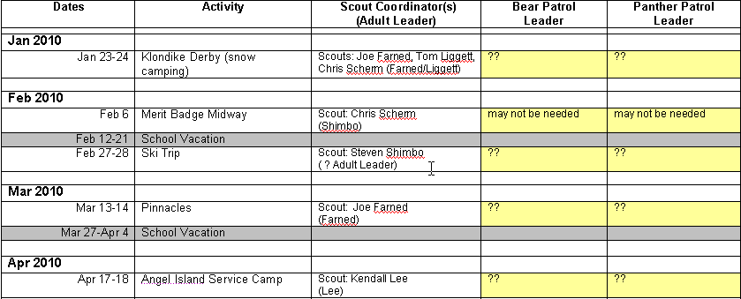
Patrol Leaders’ Council
Planning the Calendar

Slide 35
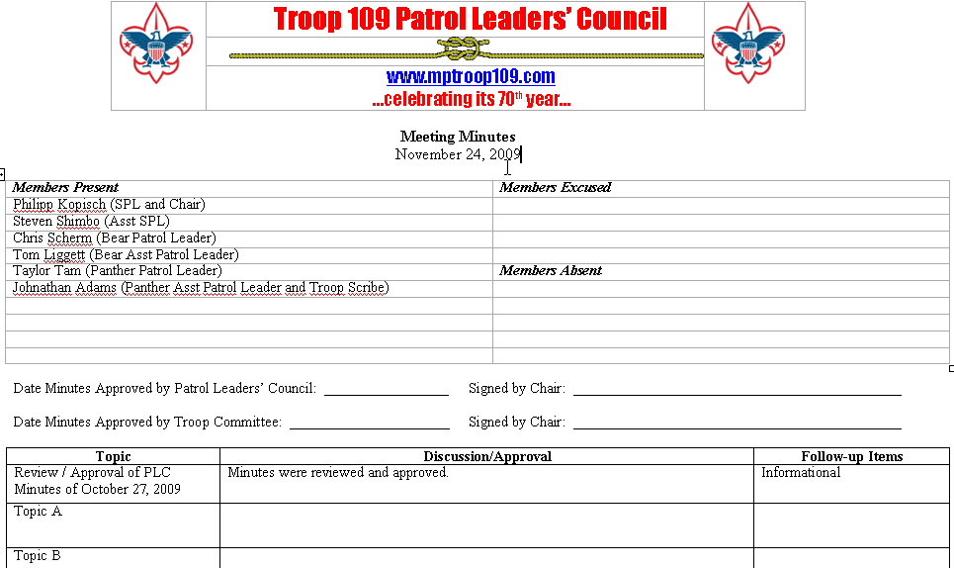
Patrol Leaders’ Council
Recording the Minutes

Slide 36
How Can I Be an Effective Leader?
Leadership = Responsibility
Not about telling people “what to do”
Help each member of the team/patrol succeed
“Others-first” leadership
  “Motivation” vs “Manipulation”
Respect is EARNED
Leadership is learned
  Mentoring/feedback by adult leaders

Slide 37
National Youth Leadership Training
Vision-Goals-Planning: Creating Positive Future Success
SMART Goals: Specific, Measureable, Attainable, Relevant, Timely
Planning and Problem-Solving: What, How, When, Who
Assessment Tool: SSC – Start, Stop, Continue
Teaching EDGE: Explain, Demonstrate, Guide, Enable
Stages of Team Development: Forming, Storming, Norming, Performing
Conflict Resolution: EAR – Express, Address, Resolve
Making Ethical Decisions: Right vs Wrong, Right vs Right, Trivial
Communication: MaSER – Message, Sender, Receiver
Valuing People: ROPE – Reach out, Organize, Practice, Experience

Slide 38
Leadership Skills
Organization and planning
  Use the available “tools” to help with this
  Delegation and duty rosters
Effective communication is key!
  Without it, all your work on planning is lost…
  What works for your group?
Conflict resolution
Knowing and using resources
  On-line resources
  Adult leaders and peers
Making ethical decisions

Slide 39
Traits of a Good Leader
Appearance
Dependability
Initiative
Personality
Type of Leadership
Attitude
Common Sense
Integrity
Oral Expression
Cooperates with Peers
Maturity
Self-Reliance
Preparation and Effective Communication!

Slide 40
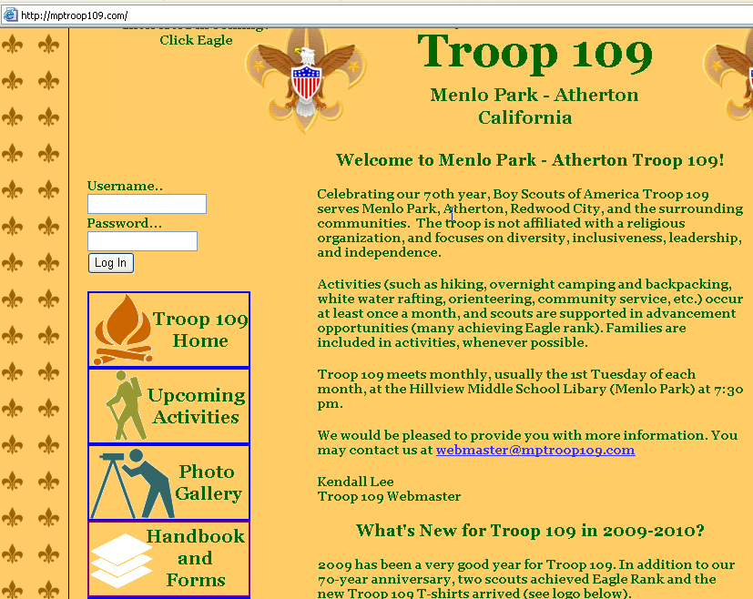
Updated Troop 109 Website

Slide 41
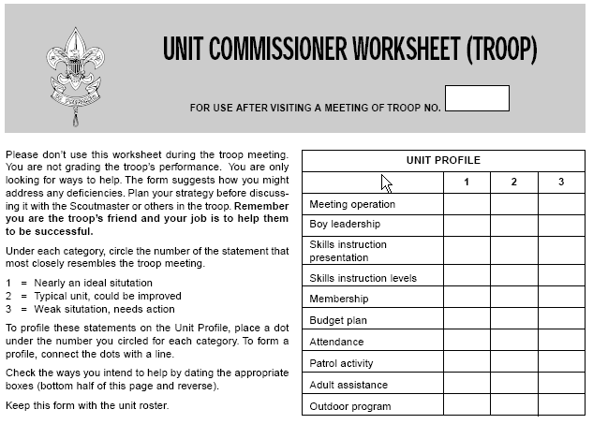
How Would BSA Rate Us?

Slide 42
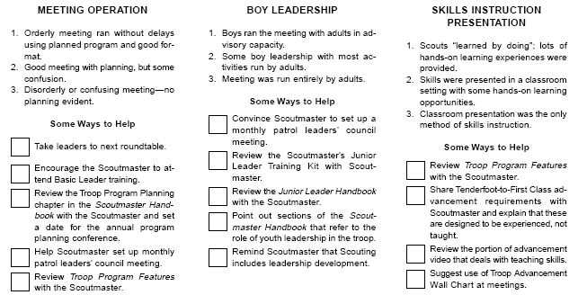
How Would BSA Rate Us?

Slide 43
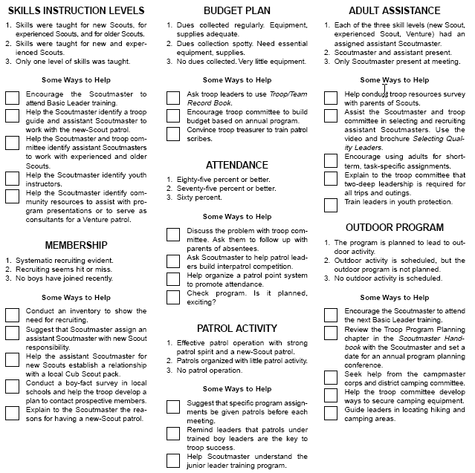

Slide 44
HOMEWORK
Why Are You a Leader?
HOMEWORK
How Can I Be an Effective Leader?
Know your responsibilities
Decide what you want to accomplish
Get to know your Scouts
  What can they do?
  What are their strengths?
  What do they need?
Learn and improve each step of the way

Slide 45
Do You Have Leadership Experiences to Share?
Have you been to NYLT?
What have you learned as a leader?
Have you had a particular challenge as a leader?
Have you had a particular success as a leader?
Discussion and Questions

